Slide 1

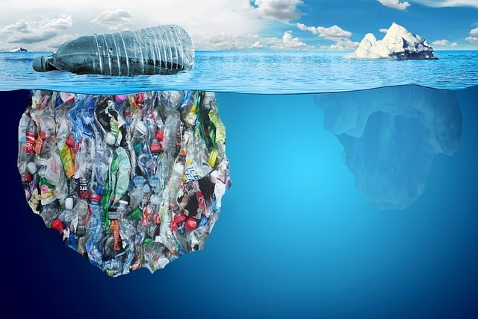


Rudra Environmental Solution (India) ltd
Waste Plastic to Poly Fuel
Thermo Catalytic Depolymerisation (TCD)
For Green Future

Slide 2
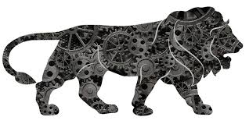

ABOUT RUDRA
Company Established in 2009
An ISO Certified Company
Converts waste plastic to Fuel through TCD
process which was developed in-house
We Manufacture TCD Plants to ensure
highest quality
Make In India Technology
Financially Viable plants
Helping Swacch Bharat Mission
For Green Future

Slide 3

PLASTIC BACKGROUND
Carbon footprint/ CO2 Emission
Non Bio Degradable
DISADVANTAGES
Garbage
culture
Pollution
High cost involved in
Disposal / mixed
Non perishable
For Green Future

Slide 4
PLASTIC POLLUTION
Over the last ten years we have produced more plastic than
during the whole of the last century.
50 percent of the plastic we use, we use just once and throw it
away.
Enough plastic is thrown away each year to circle the earth four
times
Plastic constitutes approximately 90 percent of all trash floating on the ocean’s surface
It takes 500-1,000 years for plastic to degrade.
Plastic chemicals can be absorbed by the body
Nearly every piece of plastic EVER made still exists today.
For Green Future

Slide 5
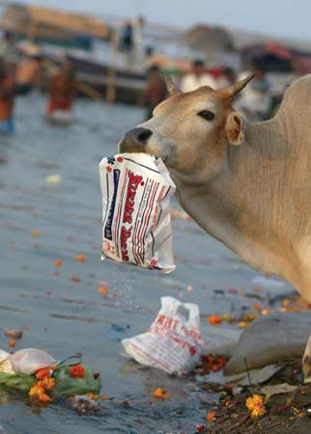
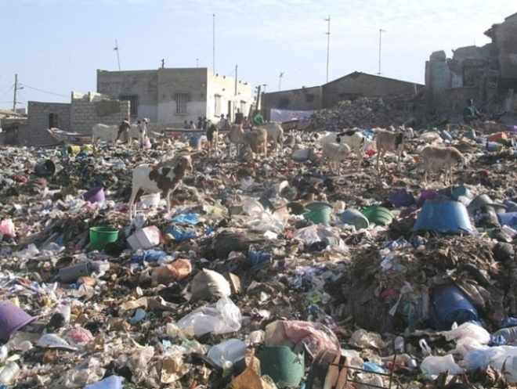
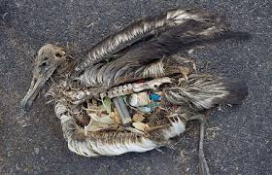
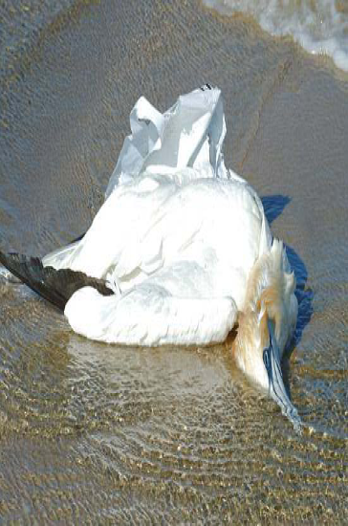
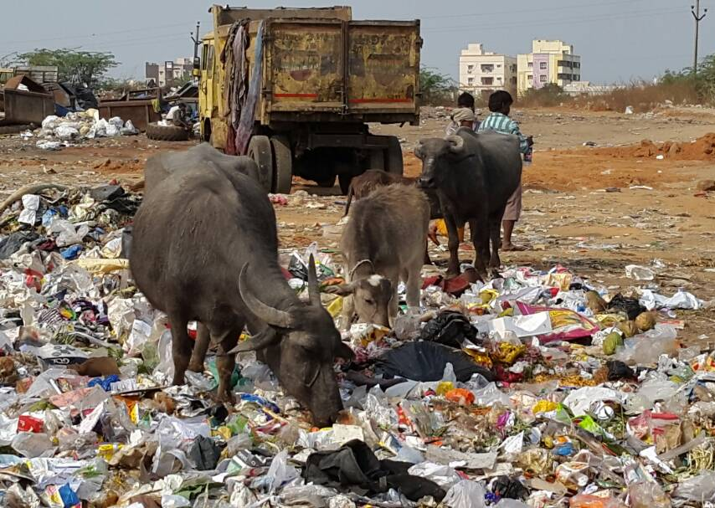
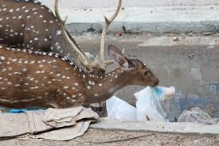
REALITY OF PLASTIC
For Green Future

Slide 6

REALITY OF PLASTIC
For Green Future

Slide 7

RUDRA SOLUTION
DON’T ADD POLLUTION BE PART OF SOLUTION
Waste Plastic to Poly Fuel
Thermo Catalytic Depolymerisation (TCD) Process
For Green Future

Slide 8
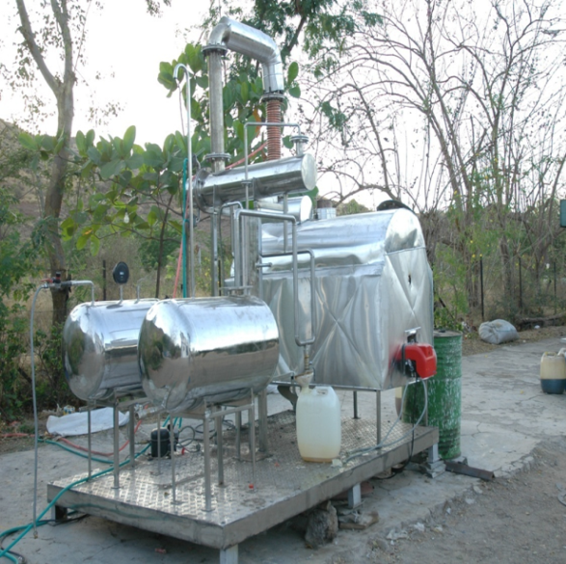
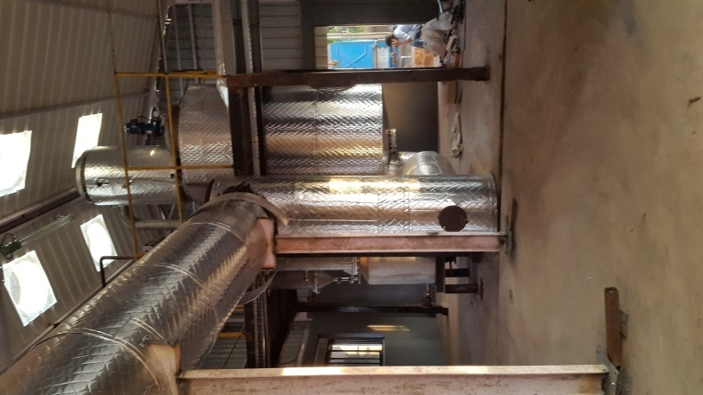
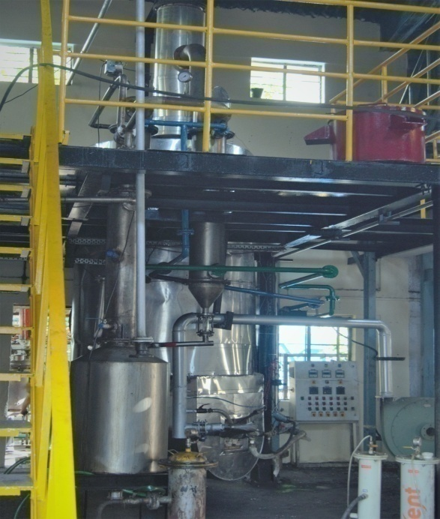
RUDRA PLANT
Current Plant of 500 Kg Capacity in our Jejuri Factory
First Trial Plant of 50 Kg Capacity
Plant of 300 Kg Capacity
For Green Future

Slide 9
RUDRA PROCESS- RECOVERY
Waste Plastic
  Plastic is shredded
Feed to reactor
Addition of catalyst
Heating
Gas and Oil Separated
Oil Filter
Gas Scrubber
Oil Storage tank
Gas storage tank
Oil for Dispatch
For Green Future

Slide 10
ADVANTAGES OF RUDRA PROCESS
Process all type / thickness of plastic
Eco-friendly Process
Energy efficient technology
Employment generation
Negative carbon footprint
For Green Future

Slide 11
BENEFITS OF RUDRA PROCESS
The machine effectively reverses the plastic production process; where the TCD process cracks the long chains of polymer with help of catalyst to produce useable fuel.
The plant is able to process plastic waste that are not easily recyclable including wrappers, other thin plastic and residual plastic waste material from businesses and households.
This will result in diversion of waste plastic from the landfill and produce fuel with lower carbon footprint.
The fuel produced can be used directly as source for burning without any need for further processing.
For Green Future

Slide 12
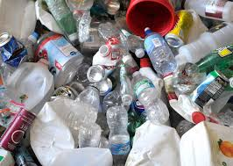
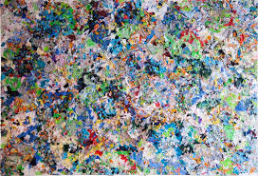
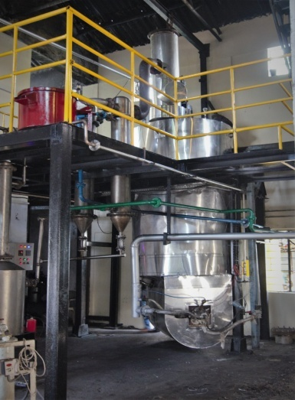
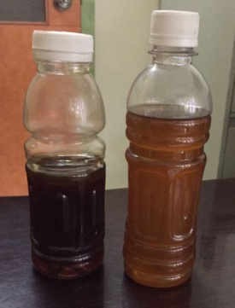
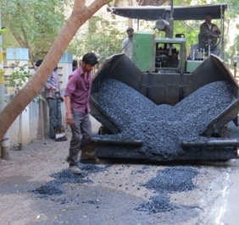
TCD PROCESS - RUDRA
Pre Process
Plant
Gas – used for heating as energy
Residue – road filling, Char
TCD process
Fuel yield
around 65%
For Green Future

Slide 13
TYPICAL INPUT OUTPUT RATIO
The machine converts waste plastic into fuel and cleaned
synthetic gas.
The exact recovery ratio and characteristics of the fuel
varies depending on the types of plastic received.
Each ton of plastics produces approximately
600 to 650 liters of fuel – Around 20% fuel used in
process
20 to 25% synthetic gas – used in the process
5 to 10% moisture
5 to 10% Residual char – can be used as road filler with
bitumen
For Green Future

Slide 14
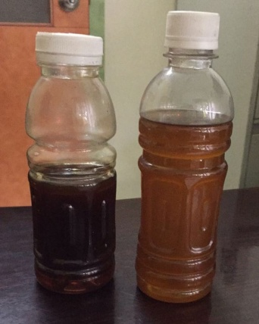
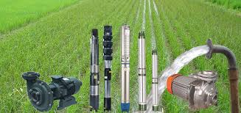
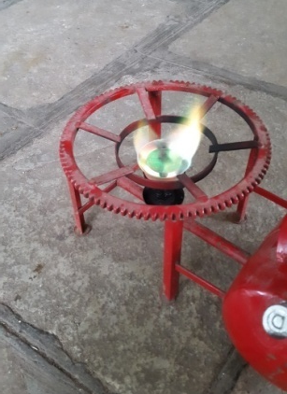
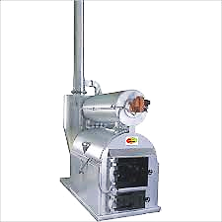
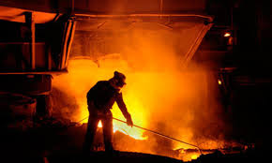
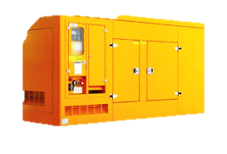
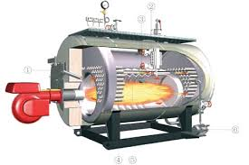


RUDRA- USE OF FUEL
Cooking stove
Agricultural Pumps
Incinerator
Furnace
Boilers
Generator
For Green Future

Slide 15

ABOUT KESHAV SITA TRUST
For Green Future

Slide 16

ABOUT KESHAV SITA TRUST
Creates awareness of waste plastic & segregation
at source
Collects waste plastic from more than 15000
households in and around Pune
Other Collection areas include Thane, Dombavali,
Baramati, Bhimashankar and nearby forts
Till date have collected more than 275 MT of
waste plastic that is Saving of 16.50 lakh KG of
emission
For Green Future

Slide 17


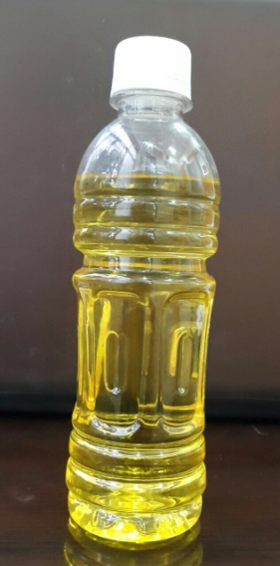

ADVANTAGES OF SEGREGATION
No need for further segregation
Helps in green audits
Easy for recycling
Helps Environment
R
Recover
Keshav Sita Trust
No Landfill
For effective waste management make 4th R ( Recovery)
part of your life
For Green Future

Slide 18
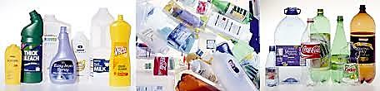
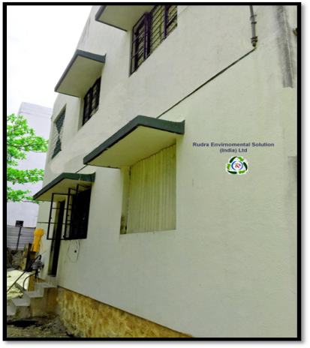
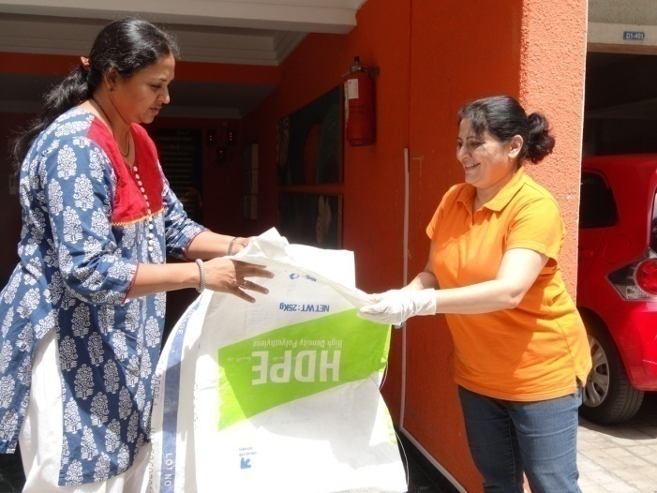
COLLECTION PROCESS- KESHAV SITA TRUST
Household waste
Waste picked by Keshav Sita Trust
For Green Future

Slide 19
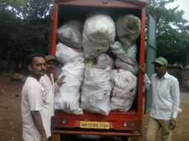
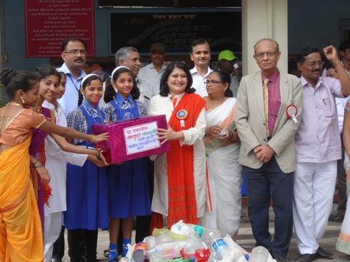
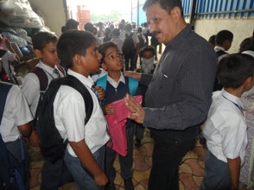
PLASTIC AWARENESS
Use of Waste Plastic in
Roads at PMC
For Green Future

Slide 20
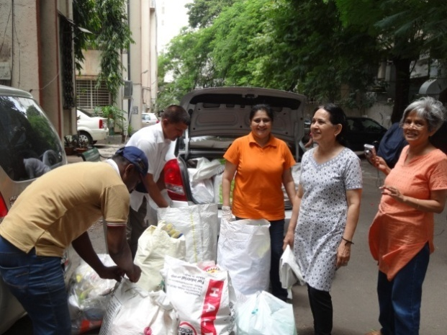
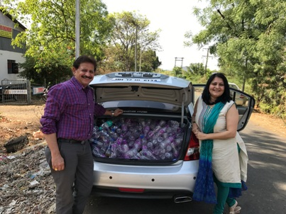
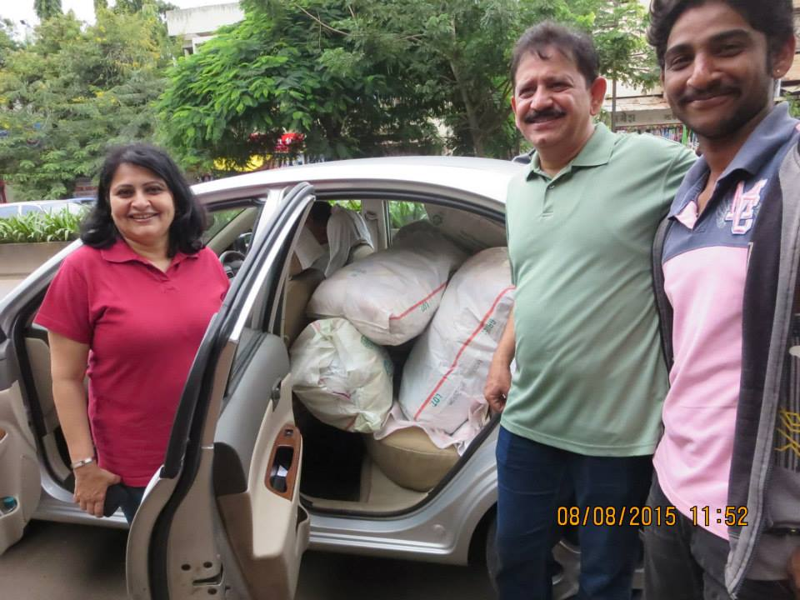
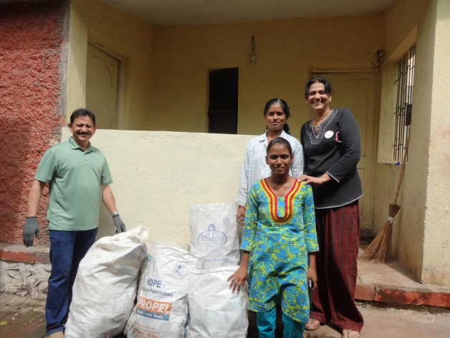
PLASTIC COLLECTION
For Green Future

Slide 21
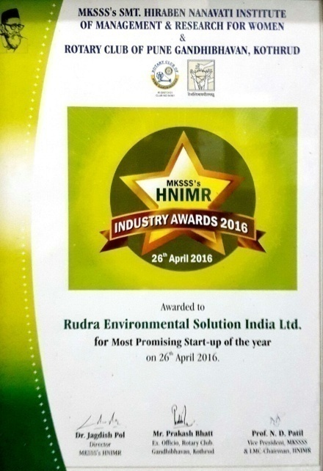
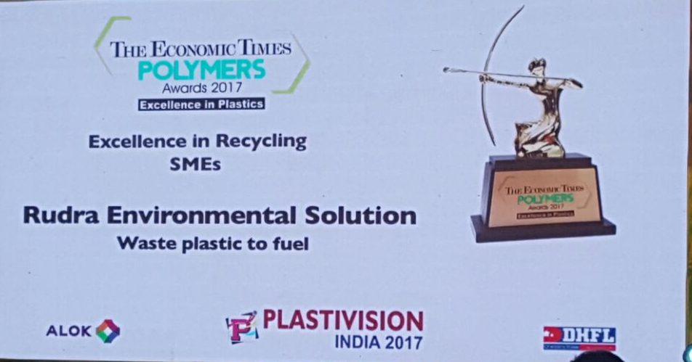
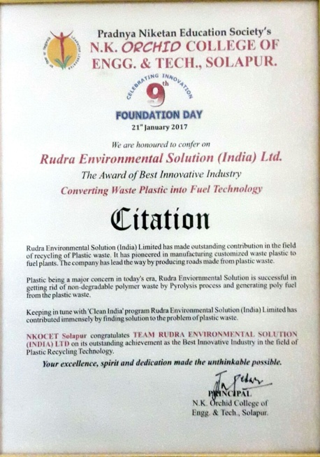
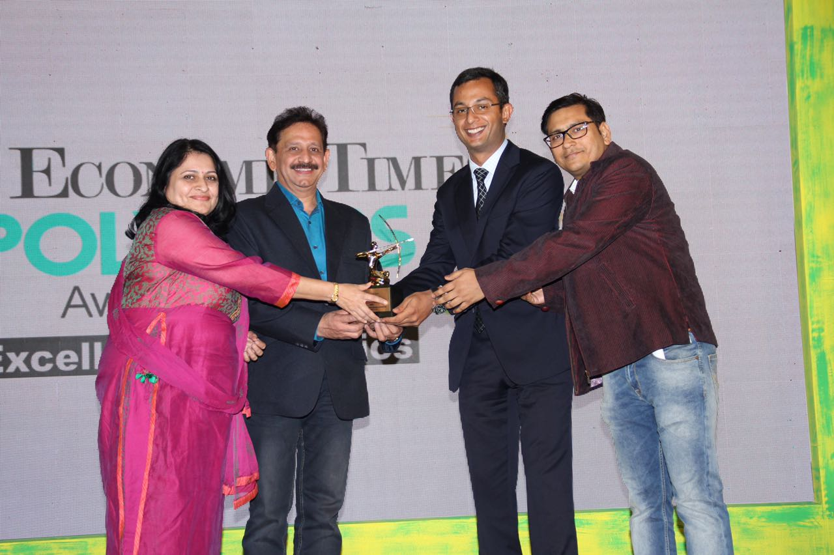
AWARDS FOR RUDRA
For Green Future

Slide 22
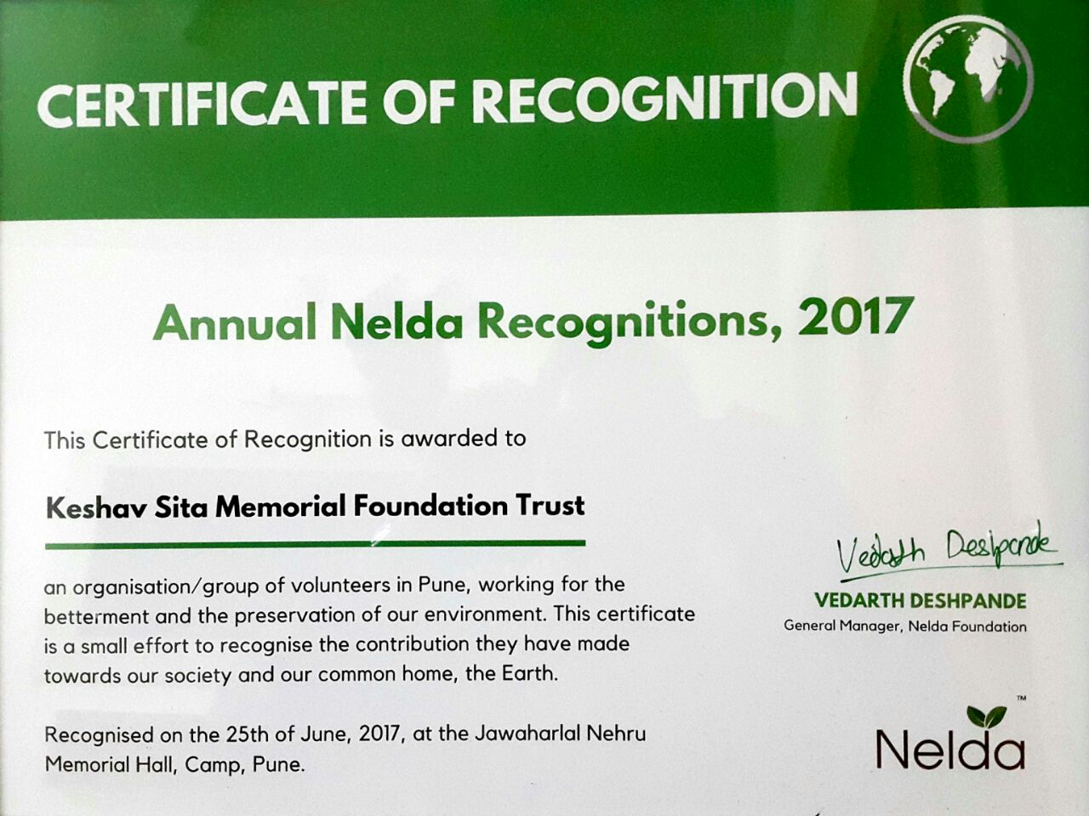
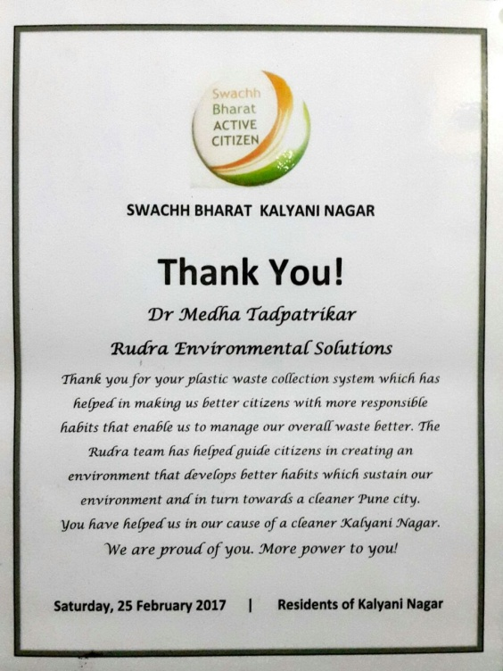
AWARDS FOR KESHAV SITA MEMORIAL FOUNDATION TRUST
For Green Future

Slide 23
Rudra Environmental Solution (India) ltd
THANK YOU
B-1 Minar Aprt,124/1 Erandwane,
Law College Rd, Pune- 411004.
Tel: (020) 25448900
Visit us at : www.rudraenvsolution.com
E-mail : rudraenvsolution@gmail.com
For Green Future

